Slide 1


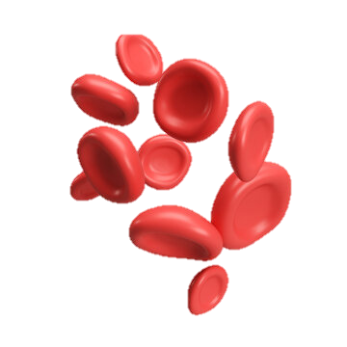
Anemia Classification and Prediction Using Blood parameters
Presented by: Chinmay Karkamkar
Nagratna
Kali Prasad

Slide 2
Project Objectives
Classify patients as anemic or normal using blood parameters.
Identify the type of anemia if present.
Compare multiple ML models.
Provide a GUI-based healthcare tool.

Slide 3
Dataset Overview
Source: anemia.csv
Features: Gender, Hemoglobin, MCH, MCHC, MCV
Cleaned for missing values

Slide 4
Feature and Target Selection
Features: Gender, Hemoglobin, MCH, MCHC, MCV
Binary classification: Anemic vs Normal
Multiclass: Iron Deficiency, Megaloblastic, Normocytic

Slide 5
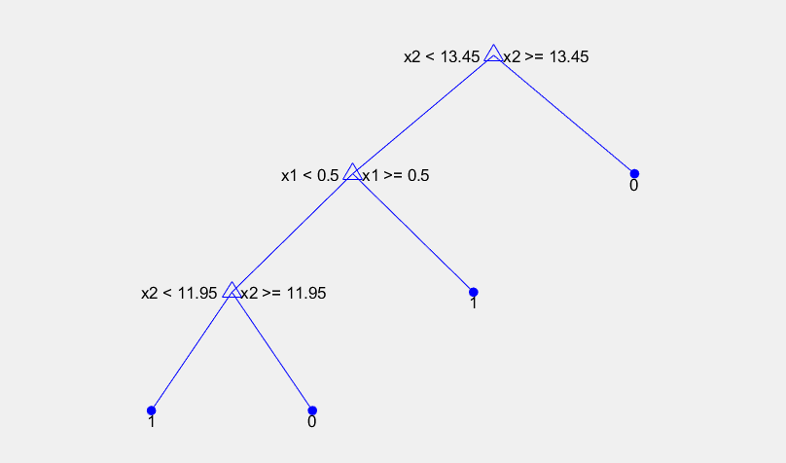
Model Training and Evaluation
Trained on 70% of data, tested on 30%
Models used:
- Decision Tree
- k-NN
- SVM
- Random Forest

Slide 6
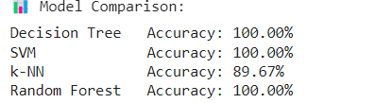
Performance Metrics
Accuracy, Precision, Recall, F1-Score
ROC Curve & AUC
Example:
- Decision Tree Accuracy: X%
- Random Forest Accuracy: Y%

Slide 7
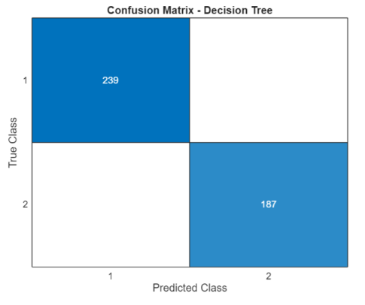
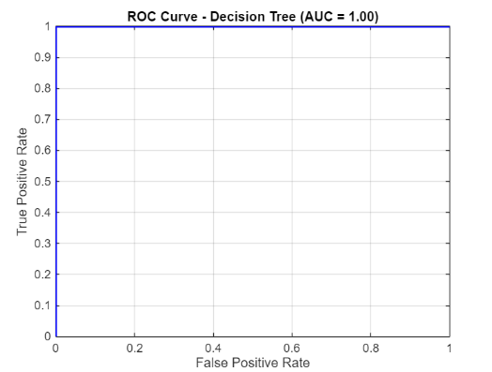
ROC Curves and Confusion Matrices
Visual comparisons using confusion matrices and ROC curves
Help assess classification strength

Slide 8
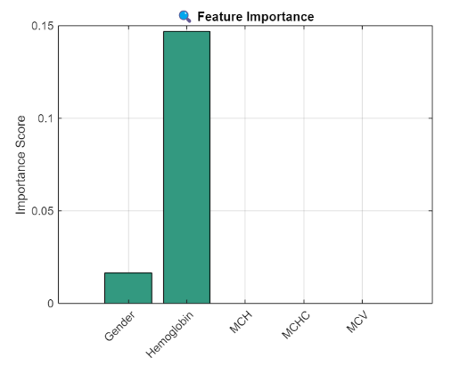
Feature Importance
Decision Tree feature weights
Hemoglobin is most impactful

Slide 9
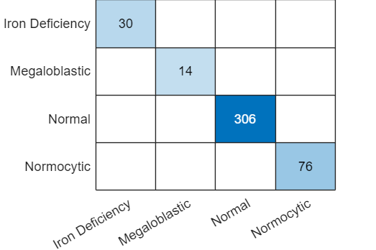
Anemia Type Classification
Types identified:
- Iron Deficiency
- Megaloblastic
- Normocytic
Based on thresholds of MCH, MCHC, and MCV

Slide 10
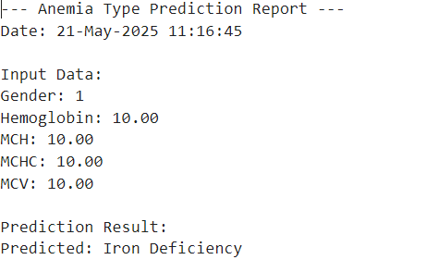
MATLAB GUI Application
Patient inputs: Gender, Hemoglobin, MCH, MCHC, MCV
Predict button gives:
- Anemia type
- Text report
- Parameter bar chart

Slide 11
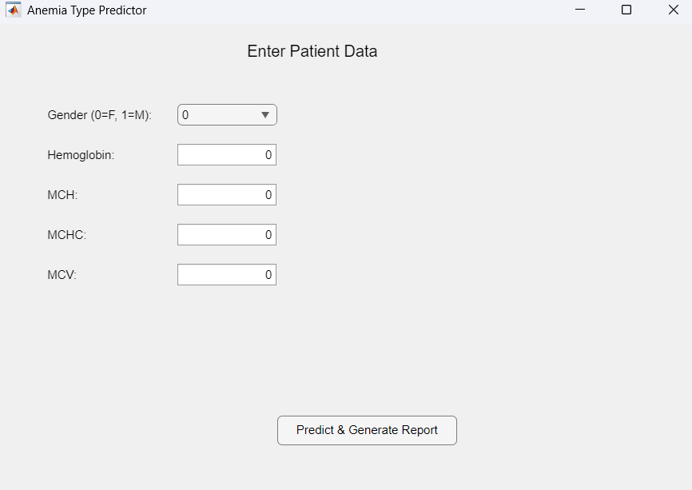
GUI Prediction Demo
Example shown with user-entered data
Real-time prediction and report generation

Slide 12
Conclusion
Developed a machine learning model to detect anemia using key hematological parameters.
Used a real-world dataset with 1,421 samples and five main features: Gender, Hemoglobin, MCH, MCHC, and MCV.
Applied a Decision Tree Classifier for its simplicity, accuracy, and interpretability in medical applications
Created a MATLAB GUI to allow easy input and prediction for non-technical users like doctors or lab staff.

Slide 13
Future Work
Cross-validation for better generalization
Future improvements may include:
Integration of additional clinical parameters
Cross-validation for better generalization
Deployment as a web or mobile diagnostic tool
Classification of different types of anemia

Slide 14
Thank you!

